Slide 1
Turistički WebGis Vodič
Studenti:
Jelena Ljubenović
Željko Laković
Mentor:
Prof. dr. Dragan Stojanović

Slide 2

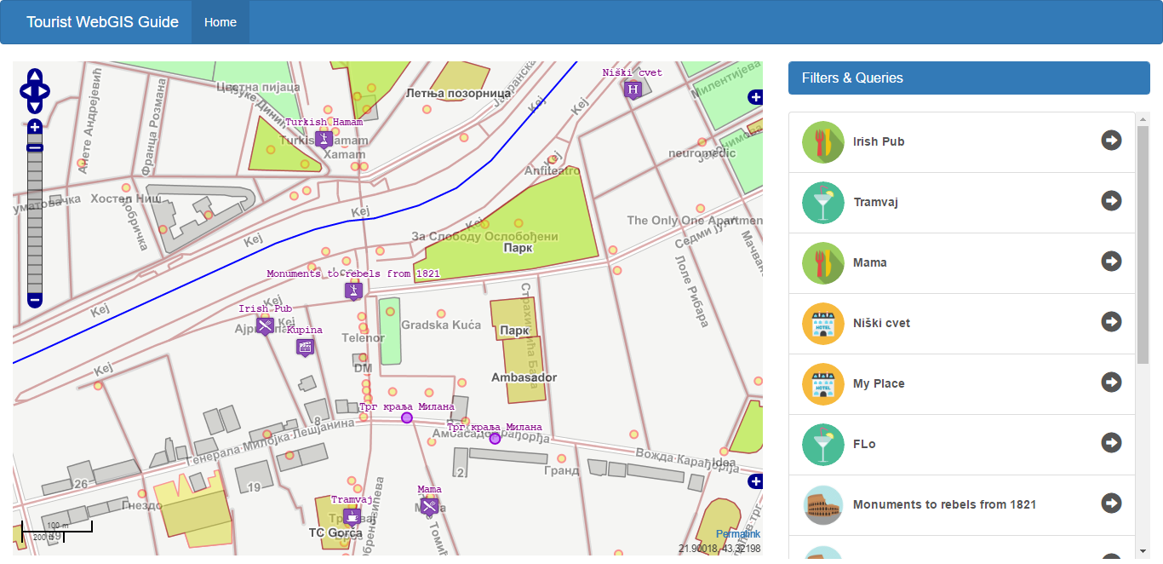
Sadržaj
Korišćene tehnologije
Interfejs i rad Web aplikacije
Slojevi postavljeni na Geoserver
Upiti

Slide 3





Korišćene tehnologije
Geoserver
PostGis (PostGres) baza podataka
OpenLayers 2 javascript biblioteka za mapiranje
jQuery i Bootstrap javascript biblioteke

Slide 4
Interfejs i rad Web aplikacije
Drop-down tab sa upitima i filterima
Početni izgled aplikacije
Mapa sa prikazanim slojevima i kontrolama
Lista objekata iz domenskog sloja dodatih na mapu

Slide 5
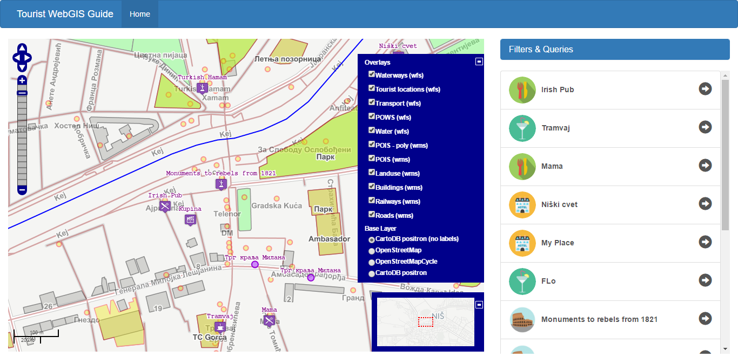
Interfejs i rad Web aplikacije
Kontrola za upravljanje dodatih slojeva različitog tipa
OpenLayers kontrole
Kontrole za upravljanje prikazom
Razmera
Prozor sa označenim granicama prikaza u odnosu na okolinu

Slide 6
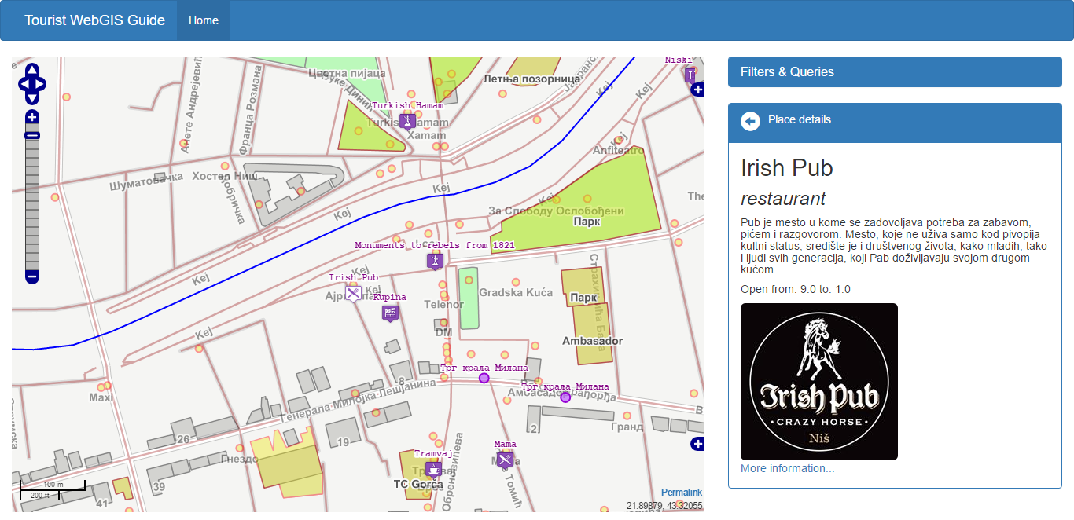
Interfejs i rad Web aplikacije
Prikaz detalja izabranog turističkog objekta
Izabrani objekat je označen komplementarnom ikonicom na mapi
Prikaz detalja objekta uključujući naziv, tip, opis, radno vreme, sliku i link do Web sajta

Slide 7
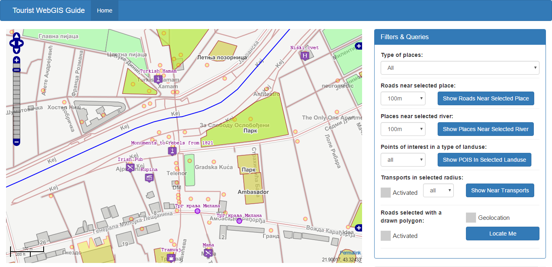
Interfejs i rad Web aplikacije
Forma sa različitim upitima i filterima
Prikaz forme sa upitima i filterima
1. Filtriranje po tipu objekta
2. Prikaz puteva u blizini objekta
3. Objekti u blizini izabrane reke
4. POIS u izabranim površinama
5. Transport u blizini izabrane tačke
Geolokacija korisnika
6. Putevi izabrani iscrtanim poligonom

Slide 8
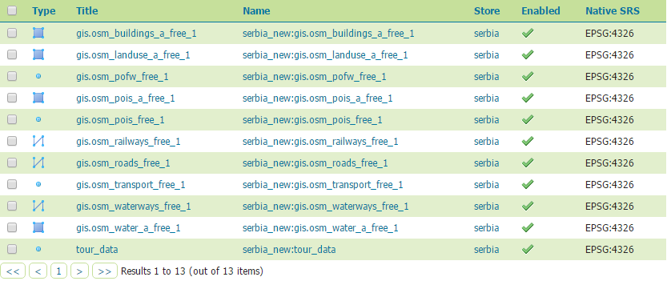
Slojevi postavljeni na Geoserver
1. Buildings
2. Landuse
3. Places of worship
4. Places of interest
5. Places of interest
– polygon
6. Railways
7. Roads
8. Transport
9. Waterways
10. Water
11. Sloj domenskih podataka za turistički vodič
Shape file-ovi su preuzeti sa http://download.geofabrik.de/europe/serbia.html i
dodati u PostGis bazu podataka. Domenski sloj je kreiran u QGis-u.

Slide 9
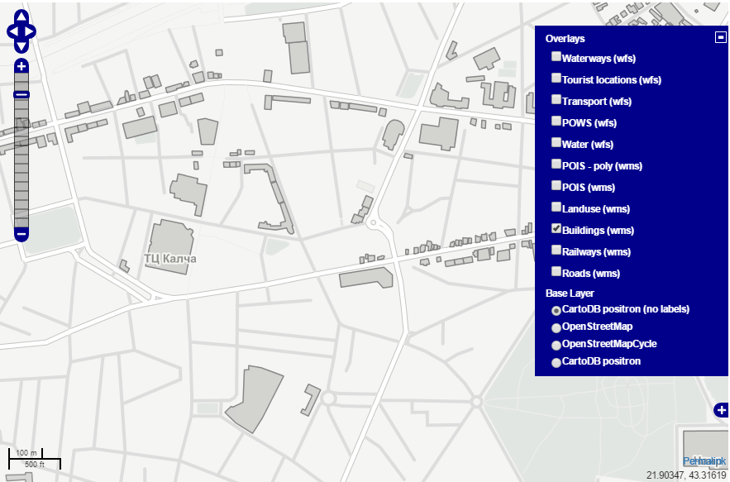
Slojevi postavljeni na Geoserver
Buildings (WMS)
var layerBuildings = new OpenLayers.Layer.WMS( "Buildings (wms)",
"http://localhost:8080/geoserver/serbia_new/wms",
{
layers: 'serbia_new:gis.osm_buildings_a_free_1',
transparent: true
},
{
isBaseLayer: false,
opacity: 0.4
});
…
map.addLayer(layerBuildings);

Slide 10
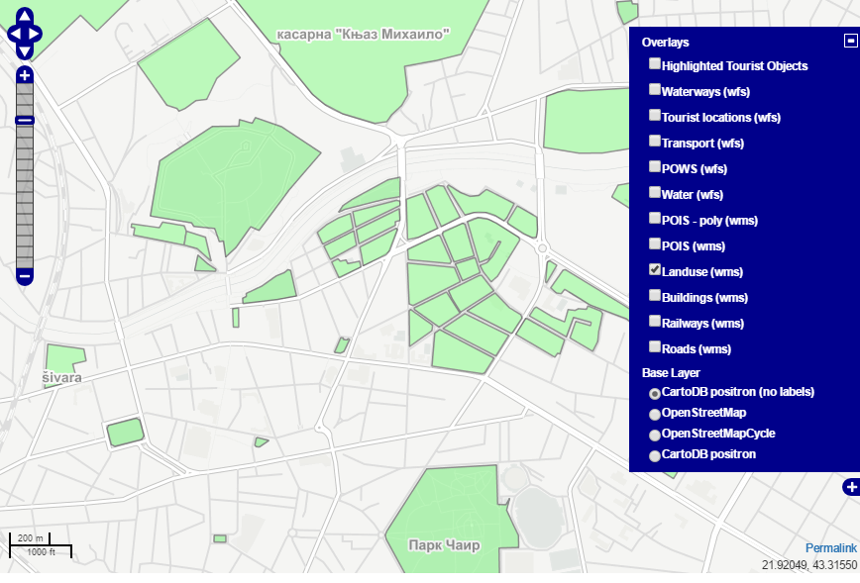
Slojevi postavljeni na Geoserver
Landuse (WMS)
var layerBuildings = new OpenLayers.Layer.WMS( "Buildings (wms)",
"http://localhost:8080/geoserver/serbia_new/wms",
{
layers: 'serbia_new:gis.osm_buildings_a_free_1',
transparent: true
},
{
isBaseLayer: false,
opacity: 0.4
});
…
map.addLayer(layerBuildings);

Slide 11
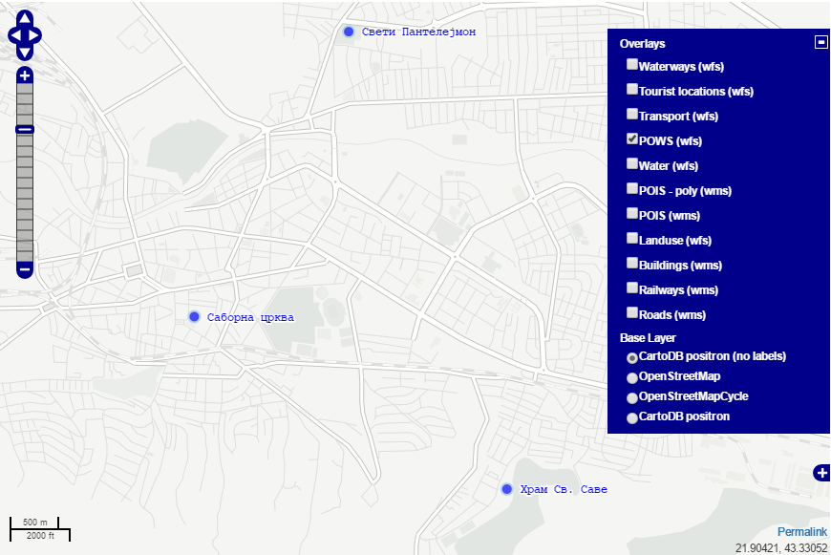
Slojevi postavljeni na Geoserver
var layerPOWS = new OpenLayers.Layer.Vector("POWS (wfs)", {
strategies: [new OpenLayers.Strategy.BBOX()],
protocol: new OpenLayers.Protocol.WFS({
url: "http://localhost:8080/geoserver/wfs",
featureType: "gis.osm_pofw_free_1",
featureNS: "http://localhost:8080/geoserver/serbia_new",
geometryName: "geom",
srsName: "EPSG:900913",
version: "1.1.0"
}),
styleMap: new OpenLayers.StyleMap({
fillColor: '#0000FF',
fillOpacity: 0.7,
strokeColor: '#ADD8E6',
pointRadius: 6, label: "${name}",
fontColor: "blue",
fontSize: "12px",
fontFamily: "Courier New, monospace",
fontWeight: "bold“,
labelAlign: "lc",
labelXOffset: "14",
labelYOffset: "0",
labelOutlineColor: "white",
labelOutlineWidth: 3
}),
renderers: renderer
});
map.addLayer(layerPOWS);
Places of Worship (WFS)

Slide 12
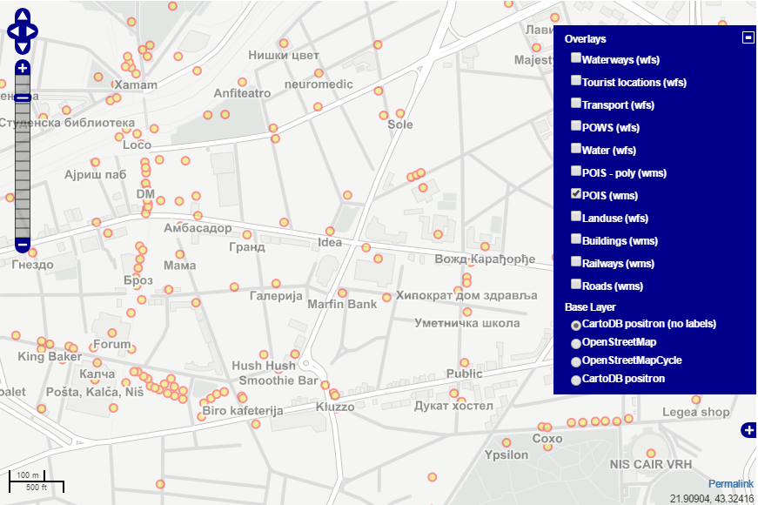
Slojevi postavljeni na Geoserver
Places of Interest (WMS)
var layerPois = new OpenLayers.Layer.WMS( "POIS (wms)",
"http://localhost:8080/geoserver/serbia_new/wms",
{
layers: 'Serbia_new:gis.osm_pois_free_1',
transparent: true
},
{
isBaseLayer: false,
opacity: 0.4
});
…
map.addLayer(layerPois);

Slide 13
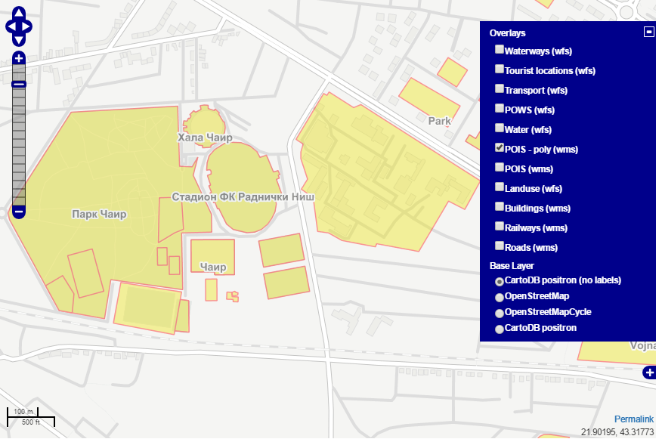
Slojevi postavljeni na Geoserver
Places of Interest - polygon (WMS)
var layerPois2 = new OpenLayers.Layer.WMS( "POIS - poly (wms)",
"http://localhost:8080/geoserver/serbia_new/wms",
{
layers: ‘serbia_new:gis.osm_pois_a_free_1',
transparent: true
},
{
isBaseLayer: false,
opacity: 0.4
});
…
map.addLayer(layerPois2);

Slide 14
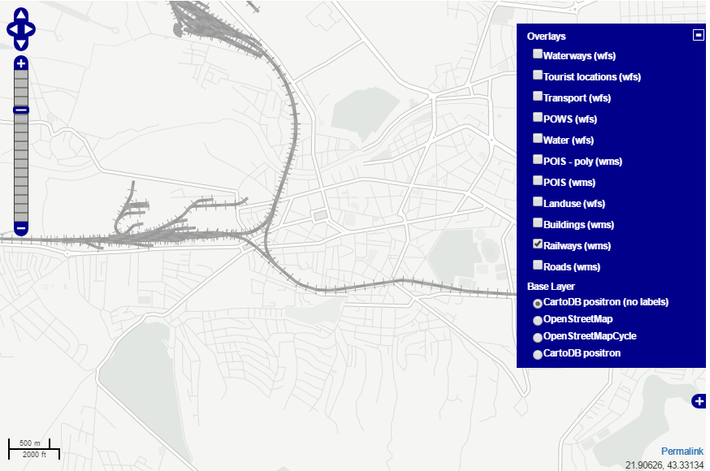
Slojevi postavljeni na Geoserver
Railways (WMS)
var layerRailways = new OpenLayers.Layer.WMS( "Railways (wms)",
"http://localhost:8080/geoserver/serbia_new/wms",
{
layers: 'serbia_new:gis.osm_railways_free_1',
transparent: true
},
{
isBaseLayer: false,
opacity: 0.4
});

Slide 15
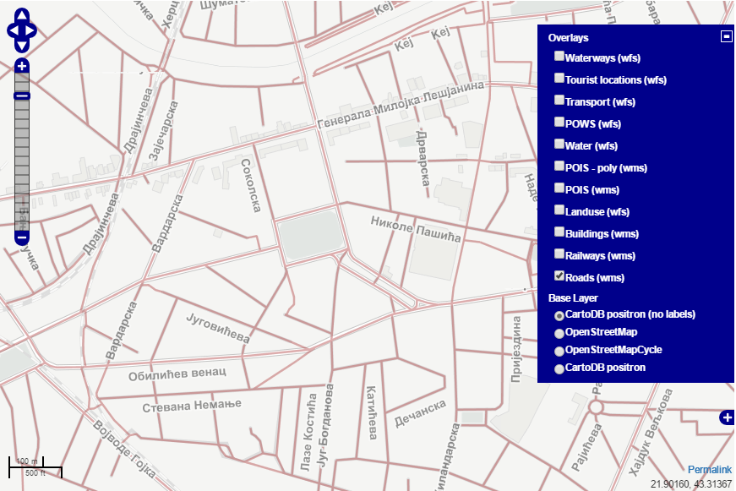
Slojevi postavljeni na Geoserver
Roads (WMS)
var layerRoads = new OpenLayers.Layer.WMS( "Roads (wms)",
"http://localhost:8080/geoserver/serbia_new/wms",
{
layers: 'serbia_new:gis.osm_roads_free_1',
transparent: true
},
{
isBaseLayer: false,
opacity: 0.4
});
…
map.addLayer(layerRoads);

Slide 16
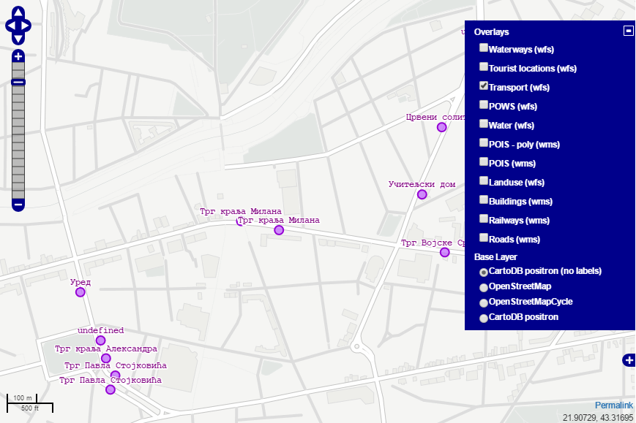
Slojevi postavljeni na Geoserver
var layerTransport = new OpenLayers.Layer.Vector("Transport (wfs)", {
strategies: [new OpenLayers.Strategy.BBOX()],
protocol: new OpenLayers.Protocol.WFS({
url: "http://localhost:8080/geoserver/wfs",
featureType: "gis.osm_transport_free_1",
featureNS: "http://localhost:8080/geoserver/serbia_new",
geometryName: "geom",
srsName: "EPSG:900913",
version: "1.1.0"
}),
styleMap: new OpenLayers.StyleMap({
fillColor: '#BF5FFF',
fillOpacity: 0.7,
strokeColor: '#9400d3',
pointRadius: 6,
label: "${name}",
fontColor: "purple",
fontSize: "12px",
fontFamily: "Courier New, monospace",
fontWeight: "bold",
labelXOffset: "0",
labelYOffset: "14",
labelOutlineColor: "white",
labelOutlineWidth: 3
}),
renderers: renderer
});
map.addLayer(layerTransport);
Transport (WFS)

Slide 17
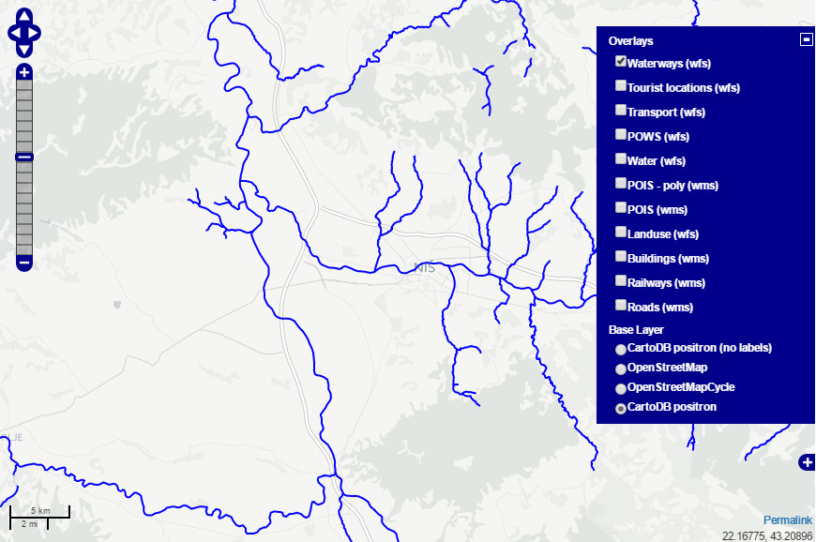
Slojevi postavljeni na Geoserver
Waterways (WFS)
var layerWaterwaysWFS = new OpenLayers.Layer.Vector("Waterways (wfs)", {
strategies: [new OpenLayers.Strategy.BBOX()],
protocol: new OpenLayers.Protocol.WFS({
url: "http://localhost:8080/geoserver/wfs",
featureType: "gis.osm_waterways_free_1",
featureNS: "http://localhost:8080/geoserver/serbia_new",
geometryName: "geom",
srsName: "EPSG:900913",
version: "1.1.0"
}),
styleMap: new OpenLayers.StyleMap({
'default' : new OpenLayers.Style({'strokeColor': '#0000FF'}),
'select' : new OpenLayers.Style({'strokeColor': '#00FFFF'})
}),
renderers: renderer
});
map.addLayer(layerWaterwaysWFS);

Slide 18
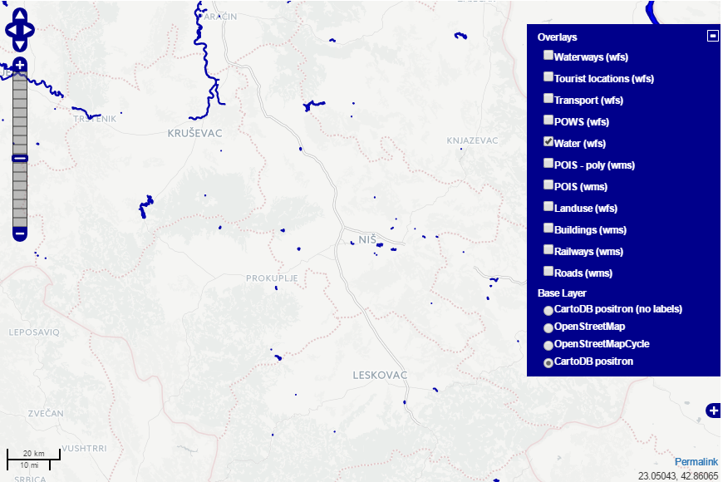
Slojevi postavljeni na Geoserver
Water (WFS)
var layerWater = new OpenLayers.Layer.Vector("Water (wfs)", {
strategies: [new OpenLayers.Strategy.BBOX()],
protocol: new OpenLayers.Protocol.WFS({
url: "http://localhost:8080/geoserver/wfs",
featureType: "gis.osm_water_a_free_1",
featureNS: "http://localhost:8080/geoserver/serbia_new",
geometryName: "geom",
srsName: "EPSG:900913",
version: "1.1.0"
}),
styleMap: new OpenLayers.StyleMap({
'fillColor': '#0000FF',
'strokeColor': '#0000AA'
}),
renderers: renderer
});
map.addLayer(layerWater);

Slide 19
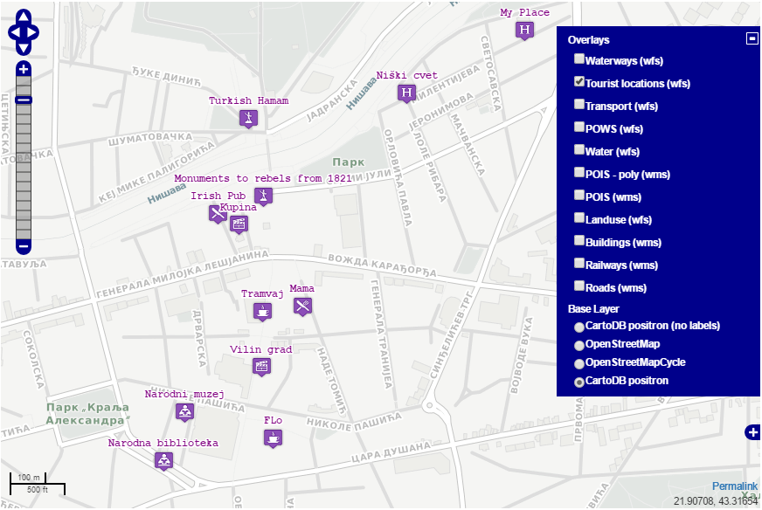
Slojevi postavljeni na Geoserver
Sloj domenskih podataka (WFS)
var layerDomainData = new OpenLayers.Layer.Vector("Tourist locations (wfs)", {
// minScale: 15000000,
strategies: [new OpenLayers.Strategy.BBOX()],
protocol: new OpenLayers.Protocol.WFS({
url: "http://localhost:8080/geoserver/wfs",
featureType: "tour_data",
featureNS: "http://localhost:8080/geoserver/serbia_new",
geometryName: "geom",
srsName: "EPSG:900913",
version: "1.1.0"
}),
styleMap: new OpenLayers.StyleMap({
'default' : domainStyle,
'select' : selectedDomainStyle
}),
renderers: renderer
});

Slide 20
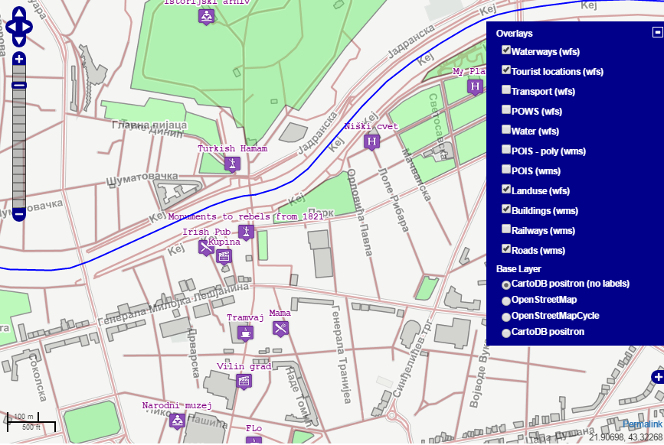
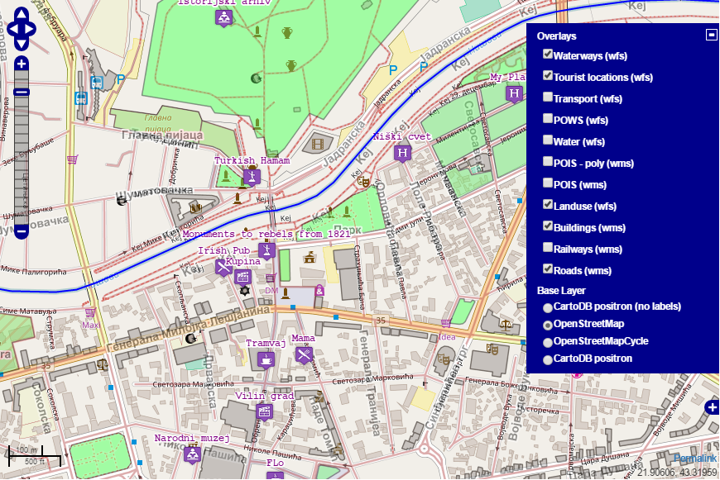
Base Slojevi
map.addLayer(new OpenLayers.Layer.OSM("CartoDB positron",
["http://a.basemaps.cartocdn.com/light_all/${z}/${x}/${y}.png",
"http://b.basemaps.cartocdn.com/light_all/${z}/${x}/${y}.png",
"http://c.basemaps.cartocdn.com/light_all/${z}/${x}/${y}.png", "http://d.basemaps.cartocdn.com/light_all/${z}/${x}/${y}.png"],
{attribution: "&copy; <a href='http://www.openstreetmap.org/copyright'>OpenStreetMap</a> contributors, &copy; <a href='http://cartodb.com/attributions'>CartoDB</a>" }));
var osmLayer2 = new OpenLayers.Layer.OSM("OpenStreetMap");
map.addLayer(osmLayer2);

Slide 21
Upiti
1. Filtriranje po tipu turističkih objekata (OGC, WFS)
2. Prikaz puteva u blizini turističkih objekata (tačka – linija) (WMS, WFS)
3. Turistički objekti u blizini izabrane reke (linija – tačka) (OGC, WFS)
4. POIS u izabranom tipu površina (landuse) (poligon – tačka) (CQL, WMS)
5. Transport u blizini izabrane lokacije (tačka – tačka) (OGC, WFS)
6. Putevi izabrani poligonom iscrtanim od strane korisnika (poligon – linija) (CQL, WMS)

Slide 22
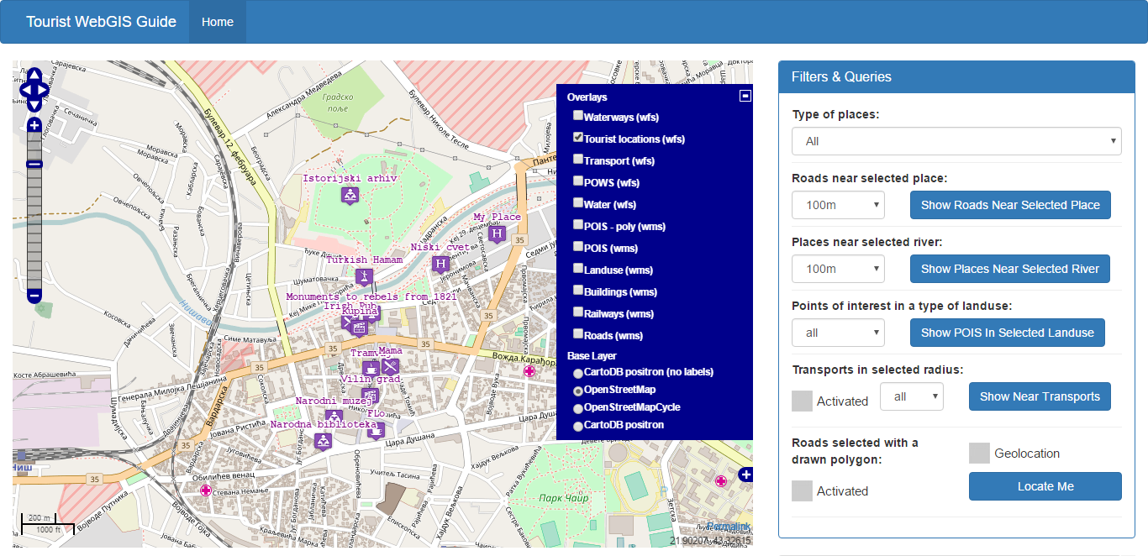
1. Filtriranje po tipu turističkih objekata

Slide 23
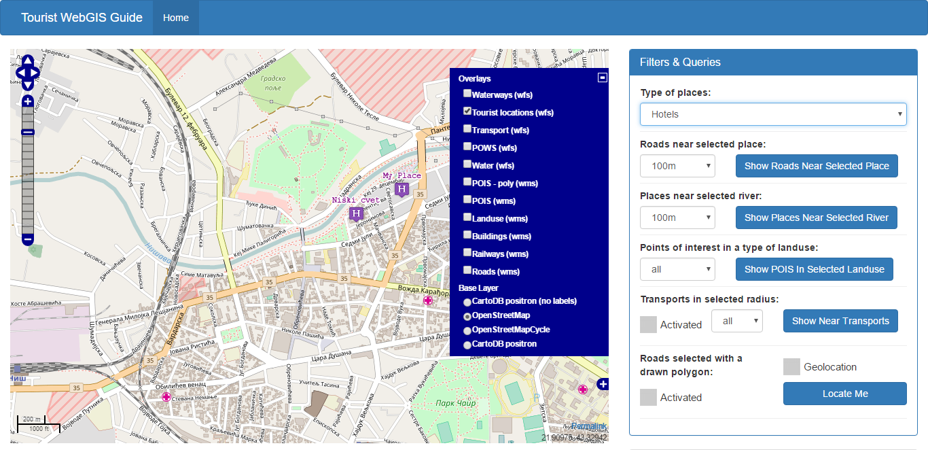
1. Filtriranje po tipu turističkih objekata

Slide 24
1. Filtriranje po tipu turističkih objekata
Prilikom promene select kontrole sa tipovima turističkih objekata postavlja se OGC filter i ponovno iscrtava sloj
Primer postavljenog filtra:
$('#places_type').on('change', function() {
if(this.value !== 'all'){
layerDomainData.filter = new OpenLayers.Filter.Comparison({
type: OpenLayers.Filter.Comparison.EQUAL_TO,
property: "type",
value: this.value
});
}
else{
layerDomainData.filter = null;
}
layerDomainData.refresh({force: true});
});
<ogc:Filter xmlns:ogc="http://www.opengis.net/ogc">
<ogc:And>
<ogc:PropertyIsEqualTo matchCase="true">
<ogc:PropertyName>type</ogc:PropertyName>
<ogc:Literal>restaurant</ogc:Literal>
</ogc:PropertyIsEqualTo><ogc:BBOX>
<ogc:PropertyName>geom</ogc:PropertyName>
<gml:Envelope xmlns:gml="http://www.opengis.net/gml" srsName="EPSG:900913">
<gml:lowerCorner>2434415.0037765 5358601.1515375</gml:lowerCorner>
<gml:upperCorner>2440778.3863805 5364142.8360875</gml:upperCorner>
</gml:Envelope></ogc:BBOX>
</ogc:And>
</ogc:Filter>

Slide 25
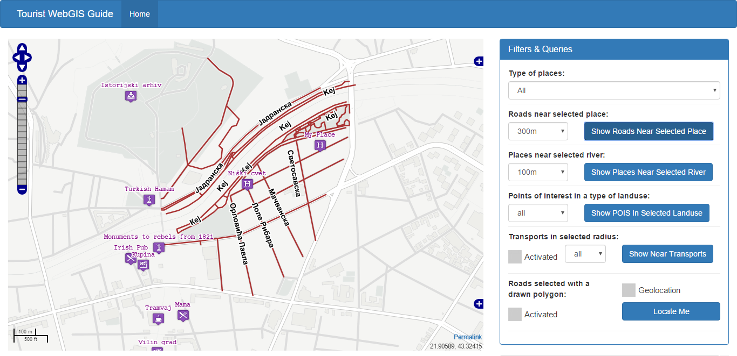
2. Prikaz puteva u blizini turističkih objekata (tačka – linija)

Slide 26
2. Prikaz puteva u blizini turističkih objekata (tačka – linija)
Prevođenje lokacije objekta u odgovarajuću projekciju, postavljanje CQL filtera i ponovno iscrtavanje sloja:
Kreiranje sloja za vizualizaciju upita:
var layerRoadsHighlightedFirstTime = true;
var layerRoadsHighlighted = new OpenLayers.Layer.WMS( "Highlighted Roads",
"http://localhost:8080/geoserver/serbia_new/wms",
{
layers: 'serbia_new:gis.osm_roads_free_1',
transparent: true
},
{
isBaseLayer: false,
opacity: 1
});
$("#button-show-roads").click(function(){
var r1 = $("#radius").val();
var selectedArray = layerDomainData.selectedFeatures;
var x = selectedArray[0].geometry.x;
var y = selectedArray[0].geometry.y;
var projWGS84 = new OpenLayers.Projection("EPSG:4326");
var proj900913 = new OpenLayers.Projection("EPSG:900913");
var originalPoint = new OpenLayers.Geometry.Point(x, y);
var transformedPoint = originalPoint.transform(proj900913, projWGS84);
layerRoadsHighlighted.params["CQL_FILTER"] = "DWITHIN(geom," + transformedPoint +"," + (r1 * r) + ",kilometers)"
if(layerRoadsHighlightedFirstTime == true){
map.addLayer(layerRoadsHighlighted);
layerRoadsHighlightedFirstTime = false;
}
else layerRoadsHighlighted.redraw(true);});

Slide 27
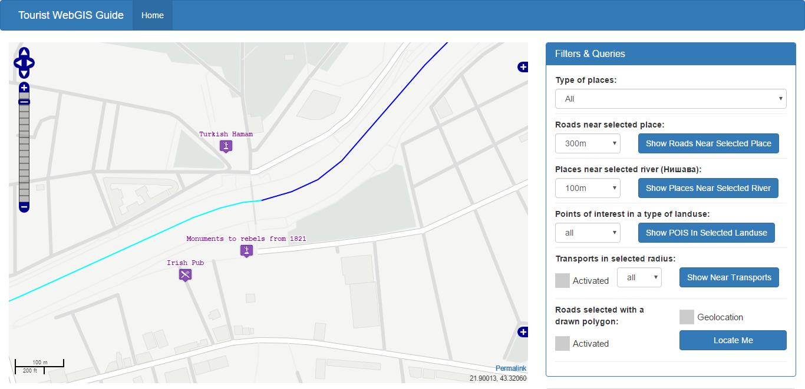
3. Turistički objekti u blizini izabrane reke (linija – tačka)

Slide 28
3. Turistički objekti u blizini izabrane reke (linija – tačka)
Preuzima se postavljeni radijus i geometrija izabrane reke koja se prevodi u odgovarajuću projekciju i koriste se za formiranje DWITHIN OGC prostornog upita i ponovo se iscrtava sloj
$("#button-show-places-near-river").click(function(){
var r1 = $("#distance-from-river").val();
var projWGS84 = new OpenLayers.Projection("EPSG:4326");
var proj900913 = new OpenLayers.Projection("EPSG:900913");
var arrayOfVertices = layerWaterwaysWFS.selectedFeatures[0].geometry.getVertices();
var arrayOfPoints = new Array();
for(var i =0; i< arrayOfVertices.length; i++){
var originalPoint = new OpenLayers.Geometry.Point(arrayOfVertices[i].x, arrayOfVertices[i].y);
var transformedPoint = originalPoint.transform(proj900913, projWGS84); arrayOfPoints.push(transformedPoint);}
var lineString = new OpenLayers.Geometry.LineString(arrayOfPoints);
layerTourHighlighted.params["CQL_FILTER"] = "DWITHIN(geom," + lineString +"," + (r1 * r) + ",kilometers)";
if(layerTourHighlightedFirstTime == true){
map.addLayer(layerTourHighlighted);
layerTourHighlightedFirstTime = false;
}
else layerTourHighlighted.redraw(true);
layerDomainData.filter = new OpenLayers.Filter.Spatial({
type: OpenLayers.Filter.Spatial.DWITHIN,
property: "geom",
value: lineString,
distance: r * r1,
distanceUnits: "kilometers",
projection: "EPSG:4326"
});
layerDomainData.refresh({force:true});
});

Slide 29
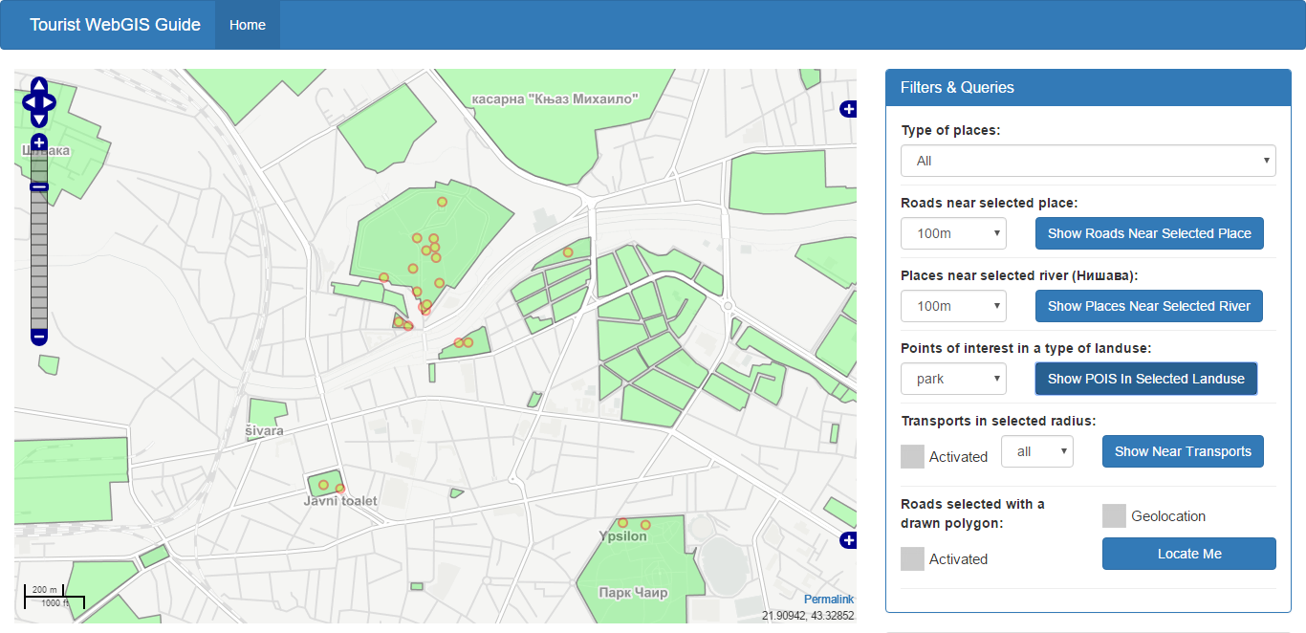
4. POIS u izabranom tipu površina (landuse) (poligon – tačka)

Slide 30
4. POIS u izabranom tipu površina (landuse) (poligon – tačka)
Na osnovu izabranog tipa površina postavlja se CQL prostorni INTERSECTS upit i pri tome se koriste funkcije queryCollection i collectGeometries koje koristi Geoserver da bi na serveru preuzeo potrebne podatke koji predstavljaju drugi parametar INTERSECTS upita.
Na ovaj način se smanjuje veličina URL-a zahteva
Potrebno je dodati Geoserver querylayer modul da bi navedeni upit bio moguć
$("#button-show-places-in-selected-landuse").click(function(){
var bbox = map.getExtent().transform(map.projection, map.displayProjection);
if($("#landuse_type").val() !== 'all')
layerPois.params["CQL_FILTER"] = "INTERSECTS(geom, collectGeometries(queryCollection('serbia_new:gis.osm_landuse_a_free_1', 'geom','BBOX(geom," + bbox.left + "," + bbox.bottom + "," + bbox.right + "," + bbox.top + ") AND fclass = ''" + $("#landuse_type").val() + "''')))";
else layerPois.params["CQL_FILTER"] = null;
layerPois.redraw(true);
});

Slide 31
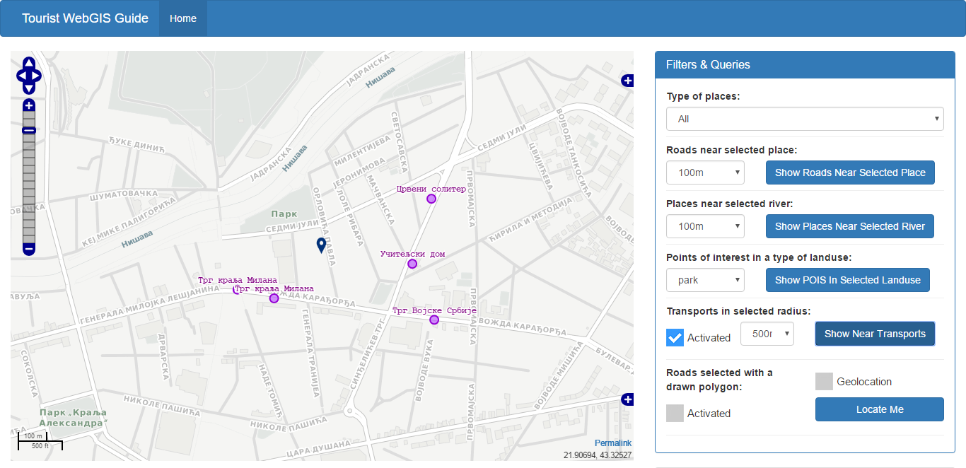
5. Transport u blizini izabrane lokacije (tačka – tačka)

Slide 32
5. Transport u blizini izabrane lokacije (tačka – tačka)
$("#button-show-transport-near").click(function(){
var projWGS84 = new OpenLayers.Projection("EPSG:4326");
var proj900913 = new OpenLayers.Projection("EPSG:900913");
var originalPoint = new OpenLayers.Geometry.Point(markers.markers[0].lonlat.lon, markers.markers[0].lonlat.lat);
var transformedPoint = originalPoint.transform(proj900913, projWGS84);
layerTransport.filter = new OpenLayers.Filter.Spatial({
type: OpenLayers.Filter.Spatial.DWITHIN,
property: "geom",
value: transformedPoint,
distance: r * $("#radius_from_point").val(),
distanceUnits: "kilometers",
projection: "EPSG:4326"
});
layerTransport.refresh({force: true});
});
Korisnik izabere lokaciju na mapi (označava se markerom)
Na osnovu lokacije postavljenog markera i izabranog radijusa postavlja se OGC filter za sloj layerTransport i vrši ponovno iscrtavanje

Slide 33
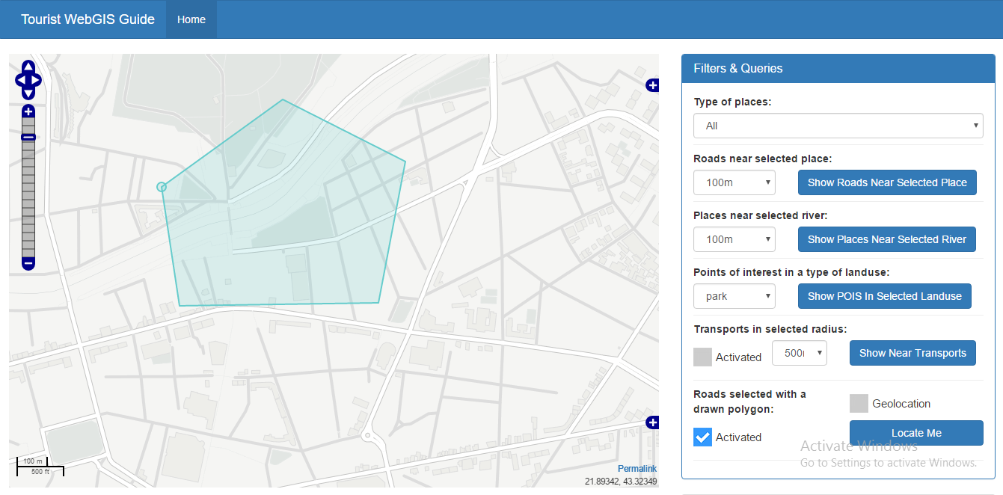
6. Putevi izabrani poligonom iscrtanim od strane korisnika (poligon – linija)

Slide 34
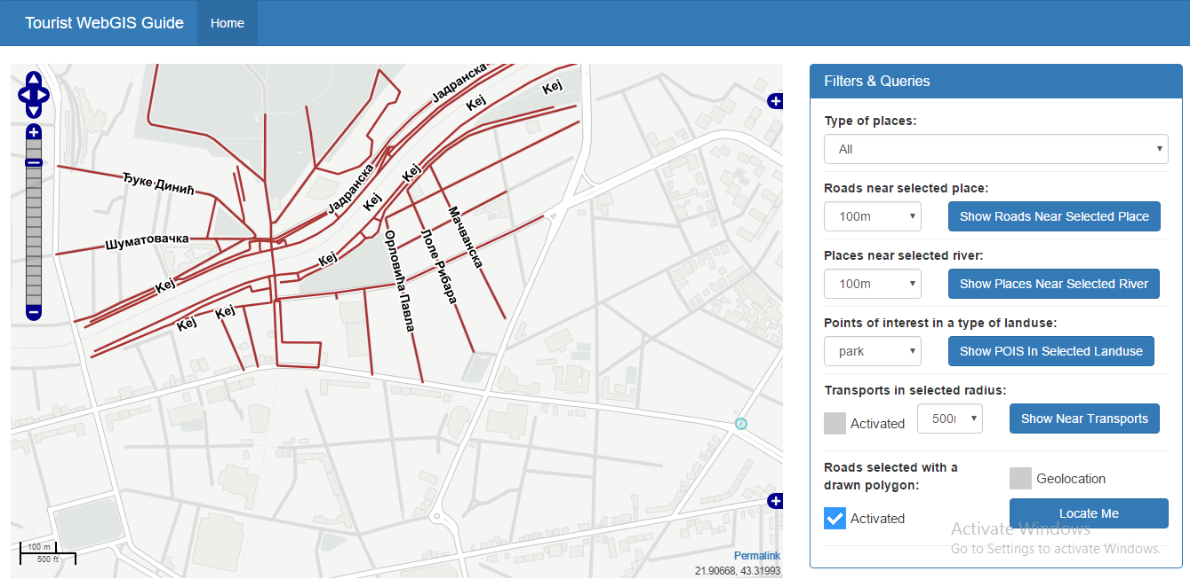
6. Putevi izabrani poligonom iscrtanim od strane korisnika (poligon – linija)

Slide 35
6. Putevi izabrani poligonom iscrtanim od strane korisnika (poligon – linija)
drawings.events.on({
beforefeatureadded: function(event) {
var geometry = event.feature.geometry;
var projWGS84 = new OpenLayers.Projection("EPSG:4326");
var proj900913 = new OpenLayers.Projection("EPSG:900913");
var arrayOfPoints = new Array();
for(var i = 0; i < geometry.components[0].components.length; i++){
var originalPoint = new OpenLayers.Geometry.Point(geometry.components[0].components[i].x, geometry.components[0].components[i].y);
var transformedPoint = originalPoint.transform(proj900913, projWGS84);
arrayOfPoints.push(transformedPoint);
}
var polygon = new OpenLayers.Geometry.Polygon(new OpenLayers.Geometry.LinearRing(arrayOfPoints));
layerRoadsHighlighted.params["CQL_FILTER"] = "INTERSECTS(geom," + polygon + ")" ;
if(layerRoadsHighlightedFirstTime == true){
map.addLayer(layerRoadsHighlighted);
layerRoadsHighlightedFirstTime = false;
}
else layerRoadsHighlighted.redraw(true);
return false;
}});
Korisnik iscrtava poligon na mapi izborom pojedinačnih tačaka poligona
Nakon duplog klika, pre nego što je iscrtani poligon dodat na mapu, preuzima se geometrija i formira CQL filter gde se vrši INTERSECTS između sloja putevi i poligona
Iscrtava se sloj označenih puteva

Slide 36
Hvala na pažnji

